Slide 1
FPGA for software developers
Miodrag Milanović

Slide 2
Introduction
Engineer
Hardware and emulation enthusiast
Software developer since year 2000
Software architect at “Levi Nine” Serbia
Worked in C,C++,C# and Java, lately in C++ only
Working on MAME emulation project since 2006
Was leading MAME project since 2012 till 2016

Slide 3
Why we are here?
Understanding hardware
To be better developer you need to know and understand how computer works.
Best way to understand how something work is to make it.
“Well I am just software developer and I don’t understand electronics…”
We will write hardware as source code and then “compile” hardware.
“Impossible” and “too hard” are just lame excuses ☺
Overall, we are here to have some fun.

Slide 4
Let’s first remind ourselves… and learn something new

Slide 5
Boolean logic
1
0
X
Z

Slide 6
Boolean operations
INPUT |  | OUTPUT
A | B | A AND B | A NAND B | A OR B | A NOR B | A NOR B | A XNOR B
0 | 0 | 0 | 1 | 0 | 1 | 0 | 1
0 | 1 | 0 | 1 | 1 | 0 | 1 | 0
1 | 0 | 0 | 1 | 1 | 0 | 1 | 0
1 | 1 | 1 | 0 | 1 | 0 | 0 | 1
AND
OR
XOR
NOT
NAND
NOR
XNOR

Slide 7
D Flip-Flop
CLK | D | R | S | Q | !Q
rising edge | 0 | 0 | 0 | 0 | 1
rising edge | 1 | 0 | 0 | 1 | 0
falling edge | x | 0 | 0 | Q | !Q
x | x | 1 | 0 | 0 | 1
x | x | 0 | 1 | 1 | 0
x | x | 1 | 1 | 1 | 1
D
Q
CLK
!Q
Rising edge
Falling edge
CLK

Slide 8
What is FPGA ?
Field-programmable gate array
Logic block – LUT + D Flip-Flop + full adder
I/O block – one per each pin
Interconnections, clock tree
Hard block – Block RAM, multipliers, DSP, CPU,…
Vendors: Xilinx, Intel/Altera, Lattice, Microsemi …

Slide 9
Logic block
Carry in
LUT
Full
Adder
D
Flip-Flop
MUX
Input
MUX
Output
MUX
Carry out
Clock

Slide 10
How do we program FPGA ?
HDL - Hardware description language
VHDL and Verilog
Analysis: parsing and validation of HDL
Synthesis: HDL -> netlist
Place-and-route: netlist -> specific FPGA technology
Assembler: specific FPGA technology -> bitstream
Programming: deploying bitstream on device (serial flash memory or directly)
Timing analysis
Simulation

Slide 11
Open source tools
Yosys - Verilog synthesis tool by Clifford Wolf
Arachne PnR - Place and route tool by Cotton Seed
Project IceStorm – Assembler, time analysis and FPGA programming tool
by Clifford Wolf and Mathias Lasser
Lattice iCE40 FPGA only
Icarus Verilog by Stephen Williams
Verilator by Wilson Snyder with Duane Galbi and Paul Wasson

Slide 12
And more…
APIO – micro-ecosystem for open FPGAs by Jesús Arroyo Torrens and Juan González (Obijuan)
FuseSoC - package manager and a set of build tools for FPGA/ASIC development by Olof Kindgren
Icestudio - graphic editor for open FPGAs by Jesús Arroyo Torrens

Slide 13
Let’s get started

Slide 14
What does computer consists of ?
CPU
Registers
ALU - Arithmetic logic unit
Control unit
Memory
I/O devices
How do we name our project ?

Slide 15
Grom-8
Simple
Not lightning fast
Thunder is always slower
Polish word is GROM
And we will put 8 in name, since it is 8 bit

Slide 16
Architecture
8 bit CPU
4 general purpose registers
12 bit address bus and PC (program counter)
Code and data segment registers (CS,DS) (4 bit)
Stack pointer (SP) (12 bit)
8-bit ALU with C-carry, Z-zero and S-sign flags

Slide 17
Instruction set 1/2
IR |  |  | 2nd | Instruction | Info
0000 | dst | src |  | MOV dst, src
0001 | 00 | reg |  | ADD reg | r0 = r0 + reg
0001 | 01 | reg |  | SUB reg | r0 = r0 - reg
0001 | 10 | reg |  | ADC reg | r0 = r0 + reg + C
0001 | 11 | reg |  | SBC reg | r0 = r0 - reg - C
0010 | 00 | reg |  | AND reg | r0 = r0 and reg
0010 | 01 | reg |  | OR reg | r0 = r0 or reg
0010 | 10 | reg |  | NOT reg | r0 = not reg
0010 | 11 | reg |  | XOR reg | r0 = r0 xor reg
0011 | 00 | reg |  | INC reg | reg = reg + 1
0011 | 01 | reg |  | DEC reg | reg = reg - 1
0011 | 10 | reg |  | CMP reg | flags of r0 - reg
0011 | 11 | reg |  | TST reg | flags of r0 and reg
0100 | 00 | 00 |  | SHL
0100 | 00 | 01 |  | SHR
0100 | 00 | 10 |  | SAL
0100 | 00 | 11 |  | SAR
0100 | 01 | 00 |  | ROL
0100 | 01 | 01 |  | ROR
0100 | 01 | 10 |  | RCL | rotate with carry
0100 | 01 | 11 |  | RCR | rotate with carry
0100 | 10 | reg |  | PUSH reg
0100 | 11 | reg |  | POP reg
0101 | dst | src |  | LOAD dst, [src]
0110 | dst | src |  | STORE [dst], src
0111 | 00 | reg |  | MOV CS, reg
0111 | 01 | reg |  | MOV DS, reg
0111 | 10 | 00 |  | PUSH CS
0111 | 10 | 01 |  | PUSH DS
0111 | 10 | 10 |  | ???
0111 | 10 | 11 |  | ???
0111 | 11 | 00 |  | ???
0111 | 11 | 01 |  | ???
0111 | 11 | 10 |  | RET
0111 | 11 | 11 |  | HLT

Slide 18
Instruction set 2/2
1000 | 00 | 00 | val | JMP val | (unconditionally jump)
1000 | 00 | 01 | val | JC val | (carry=1 jump)
1000 | 00 | 10 | val | JNC val | (carry=0 jump)
1000 | 00 | 11 | val | JM val | (sign=1 jump)
1000 | 01 | 00 | val | JP val | (sign=0 jump)
1000 | 01 | 01 | val | JZ val | (zero=1 jump)
1000 | 01 | 10 | val | JNZ val | (zero=0 jump)
1000 | 01 | 11 | val | ???
1000 | 10 | 00 | val | JR val | (unconditionally jump)
1000 | 10 | 01 | val | JRC val | (carry=1 jump)
1000 | 10 | 10 | val | JRNC val | (carry=0 jump)
1000 | 10 | 11 | val | JRM val | (sign=1 jump)
1000 | 11 | 00 | val | JRP val | (sign=0 jump)
1000 | 11 | 01 | val | JRZ val | (zero=1 jump)
1000 | 11 | 10 | val | JRNZ val | (zero=0 jump)
1000 | 11 | 11 | val | ???
1001 | high |  | low | JUMP addr
1010 | high |  | low | CALL addr
1011 | high |  | low | MOV SP,addr
1100 | xx | reg | val | IN reg,[val]
1101 | xx | reg | val | OUT [val],reg
1110 | xx | 00 | val | MOV CS,val
1110 | xx | 01 | val | MOV DS,val
1110 | xx | 10 | val | ???
1110 | xx | 11 | val | ???
1111 | 00 | reg | val | MOV reg, val
1111 | 01 | reg | val | LOAD reg, [val]
1111 | 10 | reg | val | STORE [val], reg
1111 | 11 | xx |  | ???

Slide 19
Verilog

Slide 20
Memory

Slide 21
Modules
module ram_memory(
input clk,
input [11:0] addr,
input [7:0] data_in,
input we,
output reg [7:0] data_out
);
reg [7:0] store[0:4095]
initial
begin
$readmemh("boot.mem", store);
end
always @(posedge clk)
if (we)
store[addr] <= data_in;
else
data_out <= store[addr];
endmodule

Slide 22
Inputs and outputs
module ram_memory(
input clk,
input [11:0] addr,
input [7:0] data_in,
input we,
output reg [7:0] data_out
);
reg [7:0] store[0:4095]
initial
begin
$readmemh("boot.mem", store);
end
always @(posedge clk)
if (we)
store[addr] <= data_in;
else
data_out <= store[addr];
endmodule

Slide 23
Registers
module ram_memory(
input clk,
input [11:0] addr,
input [7:0] data_in,
input we,
output reg [7:0] data_out
);
reg [7:0] store[0:4095];
initial
begin
$readmemh("boot.mem", store);
end
always @(posedge clk)
if (we)
store[addr] <= data_in;
else
data_out <= store[addr];
endmodule

Slide 24
Initial block
module ram_memory(
input clk,
input [11:0] addr,
input [7:0] data_in,
input we,
output reg [7:0] data_out
);
reg [7:0] store[0:4095];
initial
begin
$readmemh("boot.mem", store);
end
always @(posedge clk)
if (we)
store[addr] <= data_in;
else
data_out <= store[addr];
endmodule

Slide 25
Always block
module ram_memory(
input clk,
input [11:0] addr,
input [7:0] data_in,
input we,
output reg [7:0] data_out
);
reg [7:0] store[0:4095];
initial
begin
$readmemh("boot.mem", store);
end
always @(posedge clk)
if (we)
store[addr] <= data_in;
else
data_out <= store[addr];
endmodule

Slide 26
Condition check
module ram_memory(
input clk,
input [11:0] addr,
input [7:0] data_in,
input we,
output reg [7:0] data_out
);
reg [7:0] store[0:4095];
initial
begin
$readmemh("boot.mem", store);
end
always @(posedge clk)
if (we)
store[addr] <= data_in;
else
data_out <= store[addr];
endmodule

Slide 27
Non-blocking assignment
module ram_memory(
input clk,
input [11:0] addr,
input [7:0] data_in,
input we,
output reg [7:0] data_out
);
reg [7:0] store[0:4095];
initial
begin
$readmemh("boot.mem", store);
end
always @(posedge clk)
if (we)
store[addr] <= data_in;
else
data_out <= store[addr];
endmodule

Slide 28
Parallel execution
addr <= PC;
PC <= PC + 1;
SAME
PC <= PC + 1;
addr <= PC;
addr = PC;
PC = PC + 1;
NOT SAME
PC = PC + 1;
addr = PC;

Slide 29
I/O devices

Slide 30
Begin – end block
module hex_to_7seg
(
input [3:0] i_Value,
// ...
output o_Segment_G
);
reg [6:0] out = 7'b0000000;
always @(posedge i_Clk)
begin
case (i_Value)
4'b0000 : out <= 7'b0000001;
4'b0001 : out <= 7'b1001111;
// ...
4'b1110 : out <= 7'b0110000;
4'b1111 : out <= 7'b0111000;
endcase
end
assign o_Segment_A = out[6];
// ...
endmodule

Slide 31
Case
module hex_to_7seg
(
input [3:0] i_Value,
// ...
output o_Segment_G
);
reg [6:0] out = 7'b0000000;
always @(posedge i_Clk)
begin
case (i_Value)
4'b0000 : out <= 7'b0000001;
4'b0001 : out <= 7'b1001111;
// ...
4'b1110 : out <= 7'b0110000;
4'b1111 : out <= 7'b0111000;
endcase
end
assign o_Segment_A = out[6];
// ...
endmodule

Slide 32
Continuous assignment
module hex_to_7seg
(
input [3:0] i_Value,
// ...
output o_Segment_G
);
reg [6:0] out = 7'b0000000;
always @(posedge i_Clk)
begin
case (i_Value)
4'b0000 : out <= 7'b0000001;
4'b0001 : out <= 7'b1001111;
// ...
4'b1110 : out <= 7'b0110000;
4'b1111 : out <= 7'b0111000;
endcase
end
assign o_Segment_A = out[6];
// ...
endmodule

Slide 33
ALU

Slide 34
Local parameters / Constants
module alu(
input clk,
input [7:0] A,
input [7:0] B,
input [3:0] operation,
output reg [7:0] result,
output reg CF,
output reg ZF,
output reg SF
);
localparam ALU_OP_ADD = 4'b0000;
localparam ALU_OP_SUB = 4'b0001;
//...
localparam ALU_OP_RCR = 4'b1111;
reg [8:0] tmp;
always @(posedge clk)
begin
case (operation)
ALU_OP_ADD :
tmp = A + B;

Slide 35
Blocking assignment
reg [8:0] tmp;
case (operation)
ALU_OP_ADD :
tmp = A + B;
ALU_OP_SUB :
tmp = A - B;
ALU_OP_ADC :
tmp = A + B + { 7'b0000000, CF };
ALU_OP_SBC :
tmp = A - B - { 7'b0000000, CF };
// ...
endcase
CF <= tmp[8];
ZF <= tmp[7:0] == 0;
SF <= tmp[7];
result <= tmp[7:0];

Slide 36
ALU - Arithmetic operations
reg [8:0] tmp;
case (operation)
ALU_OP_ADD :
tmp = A + B;
ALU_OP_SUB :
tmp = A - B;
ALU_OP_ADC :
tmp = A + B + { 7'b0000000, CF };
ALU_OP_SBC :
tmp = A - B - { 7'b0000000, CF };
// ...
endcase
CF <= tmp[8];
ZF <= tmp[7:0] == 0;
SF <= tmp[7];
result <= tmp[7:0];

Slide 37
ALU – Bitwise logic operations
reg [8:0] tmp;
case (operation)
// ...
ALU_OP_AND :
tmp = {1'b0, A & B };
ALU_OP_OR :
tmp = {1'b0, A | B };
ALU_OP_NOT :
tmp = {1'b0, ~B };
ALU_OP_XOR :
tmp = {1'b0, A ^ B};
// ...
endcase
CF <= tmp[8];
ZF <= tmp[7:0] == 0;
SF <= tmp[7];
result <= tmp[7:0];

Slide 38
ALU - Shift operations
reg [8:0] tmp;
case (operation)
// ...
ALU_OP_SHL :
tmp = { A[7], A[6:0], 1'b0};
ALU_OP_SHR :
tmp = { A[0], 1'b0, A[7:1]};
ALU_OP_SAL :
tmp = { A[7], A[6:0], 1'b0}; // Same as SHL
ALU_OP_SAR :
tmp = { A[0], A[7], A[7:1]};
// ...
endcase
CF <= tmp[8];
ZF <= tmp[7:0] == 0;
SF <= tmp[7];
result <= tmp[7:0];

Slide 39
ALU - Rotate operations
reg [8:0] tmp;
case (operation)
// ...
ALU_OP_ROL :
tmp = { A[7], A[6:0], A[7]};
ALU_OP_ROR :
tmp = { A[0], A[0], A[7:1]};
ALU_OP_RCL :
tmp = { A[7], A[6:0], CF};
ALU_OP_RCR :
tmp = { A[0], CF, A[7:1]};
// ...
endcase
CF <= tmp[8];
ZF <= tmp[7:0] == 0;
SF <= tmp[7];
result <= tmp[7:0];

Slide 40
ALU – Flags and result
reg [8:0] tmp;
case (operation)
// ...
ALU_OP_ROL :
tmp = { A[7], A[6:0], A[7]};
ALU_OP_ROR :
tmp = { A[0], A[0], A[7:1]};
ALU_OP_RCL :
tmp = { A[7], A[6:0], CF};
ALU_OP_RCR :
tmp = { A[0], CF, A[7:1]};
// ...
endcase
CF <= tmp[8];
ZF <= tmp[7:0] == 0;
SF <= tmp[7];
result <= tmp[7:0];

Slide 41
Other operations
Multiply
{R[1],R[0]} <= R[0] * R[1];
Divide
R[0] <= R[0] / R[1];
Modulus
R[0] <= R[0] % R[1];
Shift left by 1 (multiply by 2)
R[0] <= R[0] << 1;
Shift right by 1 (divide by 2)
R[0] <= R[0] >> 1;

Slide 42
CPU

Slide 43
Wires
module grom_cpu(
input clk,input reset,
output reg [11:0] addr,
input [7:0] data_in,output reg [7:0] data_out,
output reg we,output reg ioreq, output reg hlt
);
reg[11:0] PC; // Program counter
reg[7:0] IR; // Instruction register
reg[11:0] SP; // Stack pointer regiser
reg[7:0] R[0:3]; // General purpose registers
// ...
reg [7:0] alu_a;
reg [7:0] alu_b;
reg [3:0] alu_op;
wire [7:0] alu_res;
wire alu_CF;
wire alu_ZF;
wire alu_SF;
alu alu(.clk(clk),.A(alu_a),.B(alu_b),.operation(alu_op),
.result(alu_res),.CF(alu_CF),.ZF(alu_ZF),.SF(alu_SF));
// ...

Slide 44
Using modules
module grom_cpu(
input clk,input reset,
output reg [11:0] addr,
input [7:0] data_in,output reg [7:0] data_out,
output reg we,output reg ioreq, output reg hlt
);
reg[11:0] PC; // Program counter
reg[7:0] IR; // Instruction register
reg[11:0] SP; // Stack pointer regiser
reg[7:0] R[0:3]; // General purpose registers
// ...
reg [7:0] alu_a;
reg [7:0] alu_b;
reg [3:0] alu_op;
wire [7:0] alu_res;
wire alu_CF;
wire alu_ZF;
wire alu_SF;
alu alu(.clk(clk),.A(alu_a),.B(alu_b),.operation(alu_op),
.result(alu_res),.CF(alu_CF),.ZF(alu_ZF),.SF(alu_SF));
// ...

Slide 45
Main state machine
reg [4:0] state = STATE_RESET;
always @(posedge clk)
begin
if (reset)
begin
state <= STATE_RESET;
hlt <= 0;
end
else
begin
case (state)
STATE_RESET :
begin
PC <= 12'h000;
R[0] <= 8'h00;
// ...
SP <= 12'hfff;
state <= STATE_FETCH_PREP;
end

Slide 46
Instruction fetch
STATE_FETCH_PREP :
begin
addr <= PC;
we <= 0;
ioreq <= 0;
state <= STATE_FETCH_WAIT;
end
STATE_FETCH_WAIT :
begin
// Sync with memory due to CLK
state <= (hlt) ? STATE_FETCH_PREP : STATE_FETCH;
end
STATE_FETCH :
begin
IR <= data_in;
PC <= PC + 1;
state <= STATE_EXECUTE;
end

Slide 47
Instruction decoding
STATE_EXECUTE :
begin
if (IR[7])
begin
addr <= PC;
state <= STATE_FETCH_VALUE_PREP;
PC <= PC + 1;
end
else
begin
case(IR[6:4])
3'b000 :
begin
`ifdef DISASSEMBLY
$display("MOV R%d,R%d",IR[3:2],IR[1:0]);
`endif
R[IR[3:2]] <= R[IR[1:0]];
state <= STATE_FETCH_PREP;
end

Slide 48
MOV instruction
STATE_EXECUTE :
begin
if (IR[7])
begin
addr <= PC;
state <= STATE_FETCH_VALUE_PREP;
PC <= PC + 1;
end
else
begin
case(IR[6:4])
3'b000 :
begin
`ifdef DISASSEMBLY
$display("MOV R%d,R%d",IR[3:2],IR[1:0]);
`endif
R[IR[3:2]] <= R[IR[1:0]];
state <= STATE_FETCH_PREP;
end

Slide 49
Conditional compiling
STATE_EXECUTE :
begin
if (IR[7])
begin
addr <= PC;
state <= STATE_FETCH_VALUE_PREP;
PC <= PC + 1;
end
else
begin
case(IR[6:4])
3'b000 :
begin
`ifdef DISASSEMBLY
$display("MOV R%d,R%d",IR[3:2],IR[1:0]);
`endif
R[IR[3:2]] <= R[IR[1:0]];
state <= STATE_FETCH_PREP;
end

Slide 50
Using ALU module 1/2
3'b001 :
begin
alu_a <= R[0]; // first input R0
alu_b <= R[IR[1:0]];
RESULT_REG <= 0; // result in R0
alu_op <= { 2'b00, IR[3:2] };
state <= STATE_ALU_RESULT_WAIT;
end
3'b010 :
begin
alu_a <= R[0]; // first input R0
alu_b <= R[IR[1:0]];
RESULT_REG <= 0; // result in R0
alu_op <= { 2'b01, IR[3:2] };
state <= STATE_ALU_RESULT_WAIT;
end

Slide 51
Using ALU module 2/2
STATE_ALU_RESULT_WAIT :
begin
state <= STATE_ALU_RESULT;
end
STATE_ALU_RESULT :
begin
R[RESULT_REG] <= alu_res;
state <= STATE_FETCH_PREP;
end

Slide 52
Memory operations 1/2
3'b101 :
begin
`ifdef DISASSEMBLY
$display("LOAD R%d,[R%d]", IR[3:2], IR[1:0]);
`endif
addr <= { DS, R[IR[1:0]] };
we <= 0;
ioreq <= 0;
RESULT_REG <= IR[3:2];
state <= STATE_LOAD_VALUE_WAIT;
end
3'b110 :
begin
`ifdef DISASSEMBLY
$display("STORE [R%d],R%d", IR[3:2], IR[1:0]);
`endif
addr <= { DS, R[IR[3:2]] };
we <= 1;
ioreq <= 0;
data_out <= R[IR[1:0]];
state <= STATE_FETCH_PREP;
end

Slide 53
Memory operations 2/2
STATE_LOAD_VALUE_WAIT :
begin
// Sync with memory due to CLK
state <= STATE_LOAD_VALUE;
end
STATE_LOAD_VALUE :
begin
R[RESULT_REG] <= data_in;
we <= 0;
state <= STATE_FETCH_PREP;
end

Slide 54
Computer

Slide 55
Main implementation
module grom_computer(input clk,input reset,output hlt,output reg[7:0] display_out );
wire [11:0] addr;
wire [7:0] memory_out;
wire [7:0] memory_in;
wire mem_enable;
wire we;
wire ioreq;
grom_cpu cpu(.clk(clk),.reset(reset),.addr(addr),.data_in(memory_out),
.data_out(memory_in),.we(we),.ioreq(ioreq),.hlt(hlt));
assign mem_enable = we & ~ioreq;
ram_memory memory(.clk(clk),.addr(addr),.data_in(memory_in),
.we(mem_enable),.data_out(memory_out));
always @(posedge clk)
begin
if(ioreq==1 && we==1)
begin
display_out <= memory_in;
end
end
endmodule

Slide 56
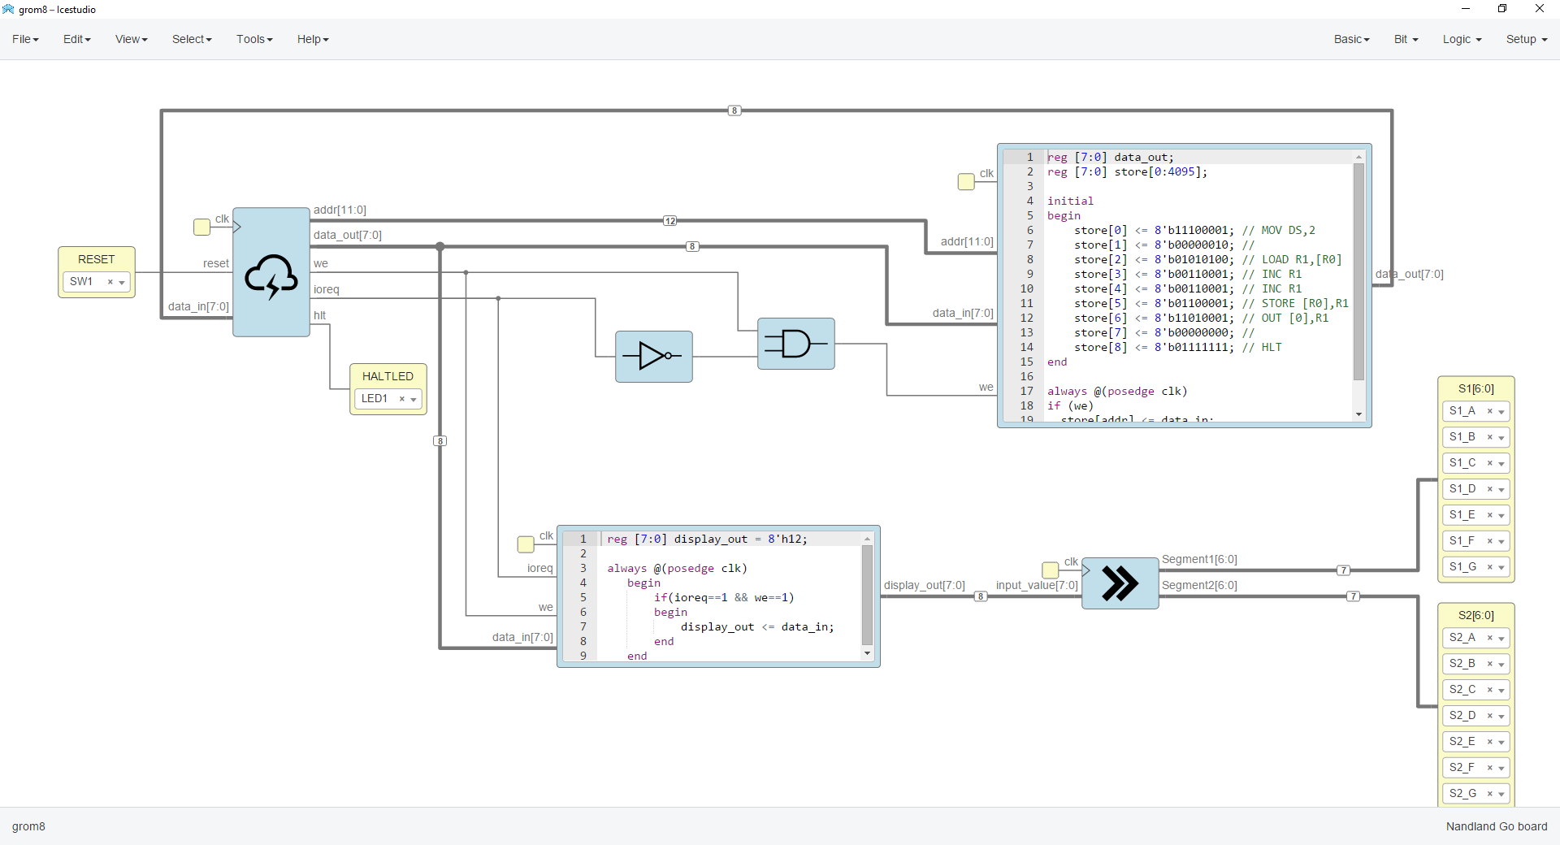
Icestudio

Slide 57
Simulation

Slide 58
Test program
store[0] <= 8'b11100001; // MOV DS,2
store[1] <= 8'b00000010; //
store[2] <= 8'b01010100; // LOAD R1,[R0]
store[3] <= 8'b00110001; // INC R1
store[4] <= 8'b00110001; // INC R1
store[5] <= 8'b01100001; // STORE [R0],R1
store[6] <= 8'b11010001; // OUT [0],R1
store[7] <= 8'b00000000; //
store[8] <= 8'b00110001; // INC R1
store[9] <= 8'b10100001; // CALL 0x100
store[10] <= 8'b00000000; //
store[11] <= 8'b01111111; // HLT
store[256] <= 8'b11010001; // OUT [0],R1
store[257] <= 8'b00000000; //
store[258] <= 8'b01111110; // RET

Slide 59
Test bench
`timescale 1ns/1ps
module grom_computer_tb();
reg clk = 0;
reg reset;
wire [7:0] display_out;
wire hlt;
grom_computer computer(.clk(clk),.reset(reset),.hlt(hlt),.display_out(display_out));
always
#(5) clk <= !clk;
initial
begin
$dumpfile("grom_computer_tb.vcd");
$dumpvars(0,grom_computer_tb);
reset = 1;
#20
reset = 0;
#900
$finish;
end
endmodule

Slide 60
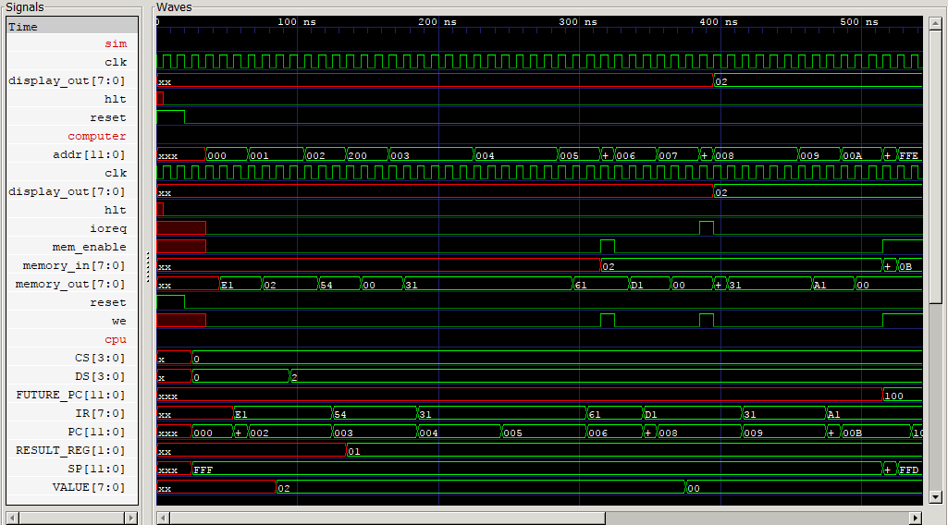

Slide 61
Text output
iverilog -D DISASSEMBLY -o grom.out grom_computer_tb.v ram_memory.v alu.v grom_cpu.v grom_computer.v
vvp grom.out
VCD info: dumpfile grom_computer_tb.vcd opened for output.
PC 001 R0 00 R1 00 R2 00 R3 00 CS 0 DS 0 SP fff ALU [x x x]
MOV DS,0x02
PC 003 R0 00 R1 00 R2 00 R3 00 CS 0 DS 2 SP fff ALU [x x x]
LOAD R1,[R0]
PC 004 R0 00 R1 00 R2 00 R3 00 CS 0 DS 2 SP fff ALU [x x x]
INC R1
PC 005 R0 00 R1 01 R2 00 R3 00 CS 0 DS 2 SP fff ALU [0 0 0]
INC R1
PC 006 R0 00 R1 02 R2 00 R3 00 CS 0 DS 2 SP fff ALU [0 0 0]
STORE [R0],R1
PC 007 R0 00 R1 02 R2 00 R3 00 CS 0 DS 2 SP fff ALU [0 0 0]
OUT [0x00],R1
Display output : 02
PC 009 R0 00 R1 02 R2 00 R3 00 CS 0 DS 2 SP fff ALU [0 0 0]
INC R1
PC 00a R0 00 R1 03 R2 00 R3 00 CS 0 DS 2 SP fff ALU [0 0 0]
CALL 100
Jumping to 100
PC 101 R0 00 R1 03 R2 00 R3 00 CS 0 DS 2 SP ffd ALU [0 0 0]
OUT [0x00],R1
Display output : 03
PC 103 R0 00 R1 03 R2 00 R3 00 CS 0 DS 2 SP ffd ALU [0 0 0]
RET
Jumping to 00b
PC 00c R0 00 R1 03 R2 00 R3 00 CS 0 DS 2 SP fff ALU [0 0 0]
HALT

Slide 62
Unit testing

Slide 63
C++ for testing 1/2
#include <iostream>
#include <memory>
#include "Valu.h"
#include "verilated.h"
#define CATCH_CONFIG_RUNNER
#include "catch.hpp"
int main( int argc, char* argv[] )
{
Verilated::commandArgs(argc, argv);
int result = Catch::Session().run( argc, argv );
return ( result < 0xff ? result : 0xff );
}

Slide 64
C++ for testing 2/2
TEST_CASE("Test ALU_OP_ADD", "ALU")
{
std::unique_ptr<Valu> top = std::make_unique<Valu>();
top->clk = 0;
for(int A=0;A<0x100;A++)
{
for(int B=0;B<0x100;B++)
{
top->A = A;
top->B = B;
top->operation = top->alu__DOT__ALU_OP_ADD;
top->clk ^= 1; top->eval();
top->clk ^= 1; top->eval();
uint8_t res = A + B;
REQUIRE(res==top->result);
REQUIRE(((res==0) ? 1:0)==top->ZF);
REQUIRE((((A + B)>0xff) ? 1 : 0 )==top->CF);
REQUIRE(((res & 0x80) ? 1 : 0) == top->SF);
}
}
}

Slide 65
Real hardware

Slide 66
Connecting with hardware
module grom_top
(input i_Clk, // Main Clock
input i_Switch_1, // SW1 button
output o_Segment1_A,
// ...
output o_Segment2_G
);
wire [7:0] display_out;
wire hlt;
grom_computer computer(.clk(i_Clk),.reset(i_Switch_1),.hlt(hlt),.display_out(display_out));
hex_to_7seg upper_digit
(.i_Clk(i_Clk),.i_Value(display_out[7:4]),
.o_Segment_A(o_Segment1_A),.o_Segment_B(o_Segment1_B),.o_Segment_C(o_Segment1_C),
.o_Segment_D(o_Segment1_D),.o_Segment_E(o_Segment1_E),.o_Segment_F(o_Segment1_F),
.o_Segment_G(o_Segment1_G));
hex_to_7seg lower_digit
(.i_Clk(i_Clk),.i_Value(display_out[3:0]),
.o_Segment_A(o_Segment2_A),.o_Segment_B(o_Segment2_B),.o_Segment_C(o_Segment2_C),
.o_Segment_D(o_Segment2_D),.o_Segment_E(o_Segment2_E),.o_Segment_F(o_Segment2_F),
.o_Segment_G(o_Segment2_G));
endmodule

Slide 67
Board definition file
### Main FPGA Clock
set_io i_Clk 15
## Push-Button Switches
set_io i_Switch_1 53
### LED Pins:
set_io o_LED_1 56
set_io o_LED_2 57
set_io o_LED_3 59
set_io o_LED_4 60
### 7 Segment Outputs
set_io o_Segment1_A 3
set_io o_Segment1_B 4
...
set_io o_Segment2_C 97
set_io o_Segment2_D 95
set_io o_Segment2_E 94
set_io o_Segment2_F 8
set_io o_Segment2_G 96

Slide 68
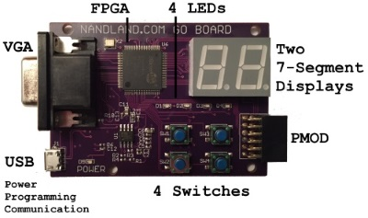
Go Board

Slide 69
Live demo

Slide 70
The End

Slide 71
More info
Full source code at https://github.com/mmicko/grom8
Nandland YouTube video channel
http://www.fpga4student.com/ for beginner tutorials
http://www.clifford.at/yosys/ for those interested in open source tools

Slide 72
Q & A

